Slide 1
Área Académica: Academia de Idioma
Tema: Simple Present
Profesor: Antonio de Jesús Osorio Romero Periodo: Enero-Julio 2016

Slide 2
Tema: Simple Present
Abstract: In this presentation we will check the use of the simple present. We learn how to use and express in third person singular an plural as well as different changes in the verb forms.
Keywords:Routine activities, verbs, pronouns, third person.

Slide 3
SIMPLE PRESENT TENSE

Slide 4
What is Simple Present?
Simple present is used to talk about an action which happens on a regular basis.
We use the present tense to talk about something that is true in the present:
EXAMPLES
I’m nineteen years old. He lives in London. I’m a student.

Slide 5
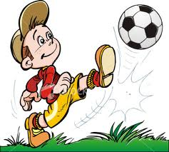
What is Simple Present
Simple present tells something that happens again and again in the present:
I play football every weekend.

Slide 6
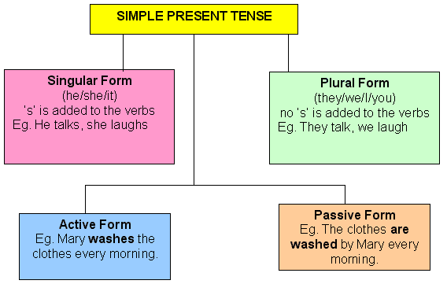
Simple Present Form

Slide 7
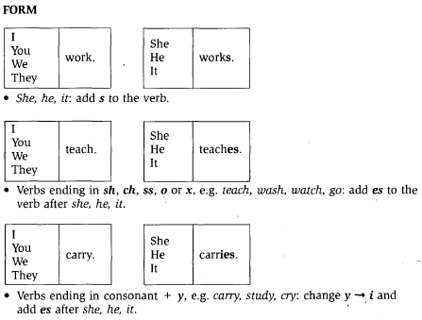
Simple Present Form

Slide 8
Usage of Simple Present
Simple present tells something that is always true:
EXAMPLES
The adult human body contains 206 bones.
Light travels at almost 300,000 kilometres per second.

Slide 9
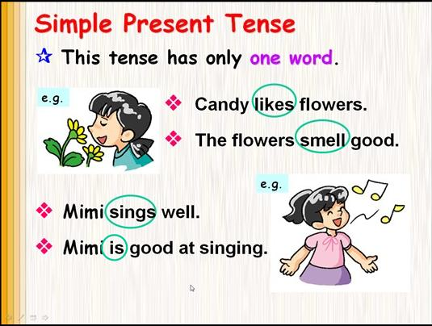

Slide 10
FORMATION OF SIMPLE PRESENT TENSE
Affirmative | Interrogative | Negative
I think | Do I think ? | I do not think.
You think | Do you think? | You don't think.
he, she, it thinks | Does he, she, it think? | He, she, it doesn't think.
we think | Do we think? | We don't think.

Slide 11
USE OF SIMPLE PRESENT
The use of the simple present:
The simple present is used:
to give your opinion - I like ice cream. I don't like spicy food.
to talk about schedules - The library opens at eight. It doesn't open at 7.
to talk about daily habits (routine actions)- Sara eats a cheese for breakfast every day. She doesn't eat cereal.
to give facts - The earth circles the sun. The moon doesn't circle the sun.
NOTE:TEACH THE KID THE USAGE OF OF SIMPLE PRESENT TENSE SENTENCES.

Slide 12
READ THE BELOW PARAGRAPH
Nancy and James are good friends .They speak good German . Nancy works in a restaurant downtown and James is a librarian . The children play in the garden every weekend . James and Nancy visit church together every Friday.

Slide 13
CHOOSE THE CORRECT OPTION
1. She always ________ in dance competitions.(participate/participates)
2. Mohan ________ every morning.(jog/jogs)
3. I _______ in France.(live/lives)
4. Jane ______ in a multinational company.(work/works)
5. Doctors ______ that junk food be avoided.(recommend/recommends)
6. He _____ angry very quickly.(get/gets)

Slide 14

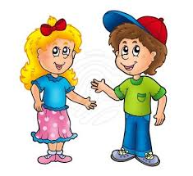

FORM SENTENCES
a) ……………………
b) …………………….
c)
…………………….

Slide 15
FILL IN THE BLANKS
a)My mother is a teacher. She _______ English.
b)Rohan is my best friend. He _______ soccer.
c) _____ you know the way out of this building?
d) What ______ your father do?
e) You can't ______ without water.

Slide 16


